Slide 1

Our AMAZING Scalable and Persistent Cloud App
William Gates (n1234567) and Mark Zuckerberg (n7654321)
CAB432 Cloud Computing 2019
Queensland University of Technology

Slide 2
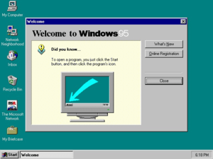
The App
An Amazingly cool idea
A social network to look and feel like Windows 95
Watch us scale out as everyone wants to use it…
https://en.wikipedia.org/wiki/Windows_95#/media/File:Windows_95_at_first_run.png

Slide 3
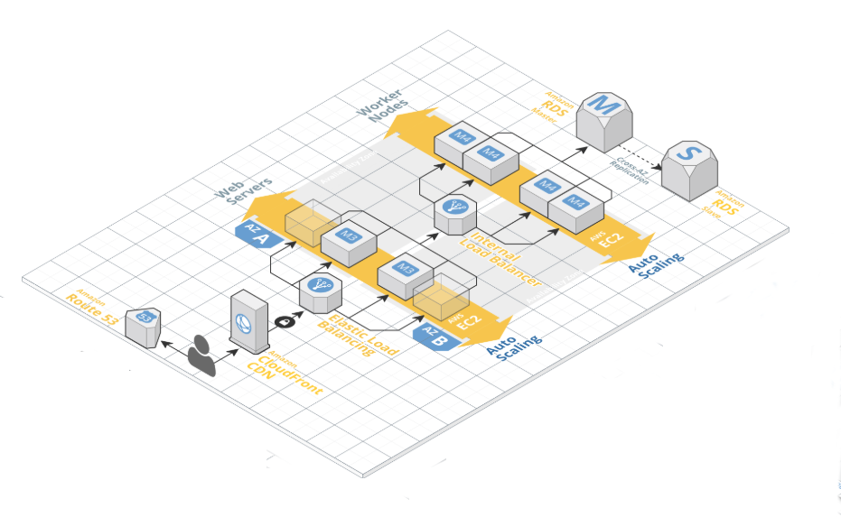
The Architecture
https://cloudcraft.co/

Slide 4
Scaling
Image courtesy of Jacob Marks – other alternatives are possible.

